Slide 1
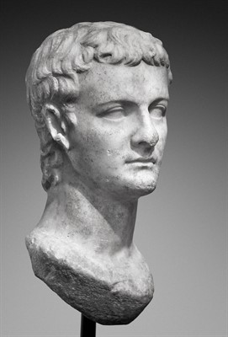
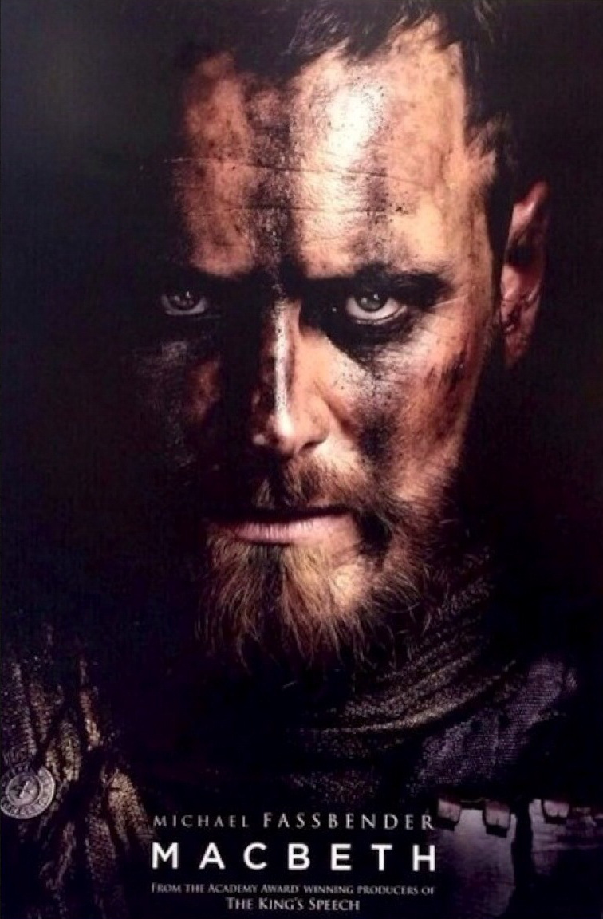
Caligula vs Macbeth
The two tyrants that became delusional

Slide 2
Background Info
Caligula was a roman male whose birth name was Gaius Julius Caesar Augustus Germanicus, and was born in 12 AD and died in 41 AD. His nickname,little boot or Caligula, came from the soldier's outfit he wore as a boy. Caligula's father died in 19 AD and shortly after his mother and the rest of his brothers were killed leaving Caligula as the only male survivor. Tiberius the emperor Caligula succeeded died in 37 AD, and Caligula assumed the title of emperor. Tiberius was ill before his death but it's rumored that caligula and a pretorian guard smothered him with a pillow. During the early years of Caligula's reign, the people loved him because he freed the wrongfully imprisoned by his predecessor Tiberius, and threw lavish banquets for the people. This was a welcome change to Tiberius's rule.

Slide 3
Background Cont.
This all changed when Caligula fell dreadfully ill in 37 AD and was on death's door. He fought off the disease but, he changed, he became diabolical and started killing torturing, or exiling any he felt posed a threat to him. He killed for no reason and started imposing strange laws, laws that stated you weren't to speak of goats around him because he was abnormally hairy, and the punishments for these crimes were usually torture or death. Caligula started on a downward spiral and soon started claiming divinity and killing on a whim. Caligula also had many unsuccessful military campaigns during his time. He also wished to place his horse on the roman consul, but was denied by the members of the senate. Caligula reigned for four years before he was killed by a squad of pretorian guards. His wife and daughter shared were killed along with him.

Slide 4
Comparison to Macbeth
-Both men suffered from nightmares that denied them sleep. “Still it cried,” sleep no more.””(ii,ii,42)
-Both started out being loved and hailed as a hero by the people but in the end were resented for their cruel and brutal acts.” For brave Macbeth-well he deserves that name.”(i,ii,16-17)
- Both had a hand in the death of their predecessors.” I have done the deed.”(ii,ii,15)
- Both only ruled for a short time and then were killed by those who should have been protecting them.”The usurpers cursed head:the time is free”(v,vii,84)
4

Slide 5
Comparison to Macbeth
-Both Killed any who they deemed a threat.”We shall,my lord,perform what you command us.”(iii,i,127-128)
-Both started to spiral into madness “The fit is momentary; upon a thought he will be well again”(iii,iv,55-56)
-Both thought they were immortal and could not be killed.”I b a charmed life.”(v,vii,41)

Slide 6
Human Rights Violations
Articles 3,5 & 1. These articles state that you should act in a spirit of brotherhood towards one another, all people have the right to life, liberty and security of person, No person shall be subjected to torture or to cruel, inhuman or degrading punishments.
-Caligula frequently killed and tortured his people
Ex.A parent was forced to watch his son being executed and then invited to a celebration and forced to make fun of the execution.
Article 9 states that no one will be subject to arbitrary arrest or exile.
Ex. Caligula exiled people plenty of times.

Slide 7
Human rights violations cont
Article 10 states everyone is entitled to a public hearing.
Ex.Caligula never gave people hearings when he restored the treason trials
Article 19 states everyone has the freedom of expression and opinion.
Ex.If people spoke out against Caligula they would be hauled to jail to await their execution or would be tortured to death.

Slide 8
Discussion Questions
Why do you think after Caligula’s life and death experience would he become such a insane ruler?
Do you think the death of most of his family made Caligula the violent and deranged person he is? Why?
Why do you think Caligula was trying to make his horse consul? Should he have been allowed?
Tiberius, The former emperor who raised Caligula, stated “ I am nursing a viper for the people of rome.” why do you think he said this?

Slide 9
Works cited
http://www.wikireedia.net/wikireedia/index.php?title=Caligula_-_Atrocities_and_Tortures#Tortures
http://penelope.uchicago.edu/Thayer/E/Roman/Texts/Cassius_Dio/59*.html
http://www.roman-empire.net/emperors/caligula.html
http://www.biography.com/people/caligula-9235253#reign-of-power
http://www.history.com/topics/ancient-history/caligula
http://miamioh.edu/cca/academics/departments/theatre/production-season/current-season/macbeth/index.html
http://twitchfilm.com/2015/05/macbeth-get-a-glimpse-of-fassbender-in-two-clips-from-justin-kurzels-film-adaptation.html
https://m.youtube.com/watch?v=FUTiEG3BeXQ

